Slide 1
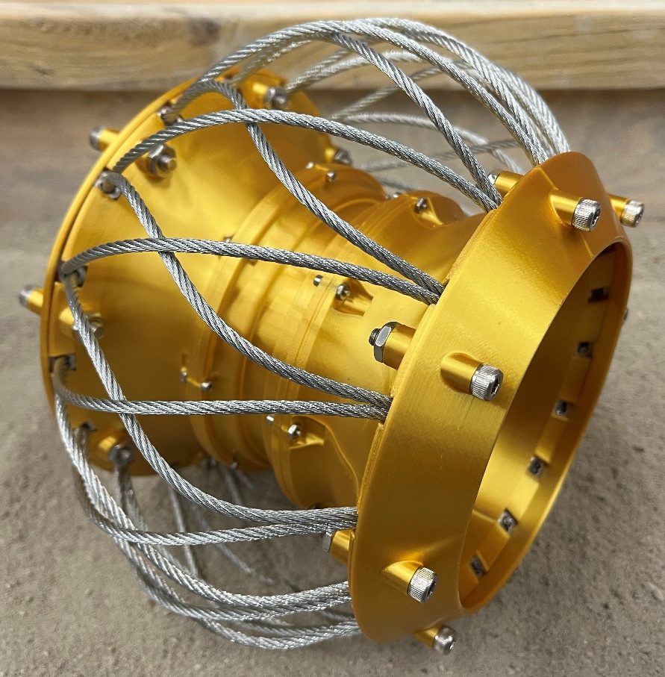
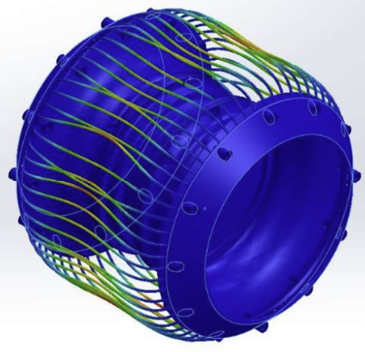
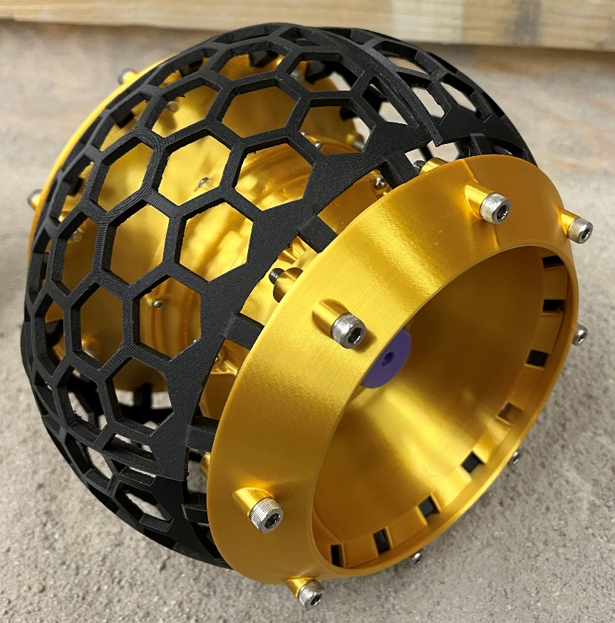
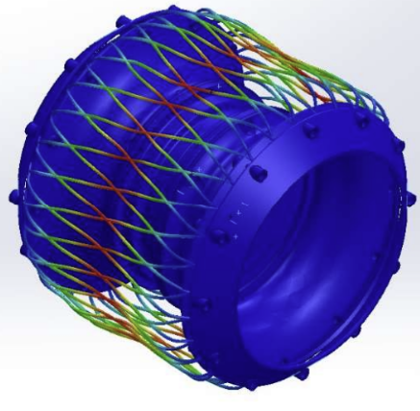
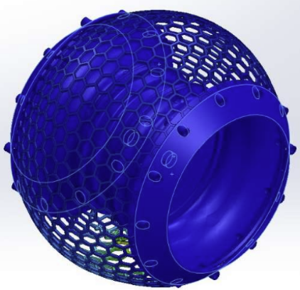
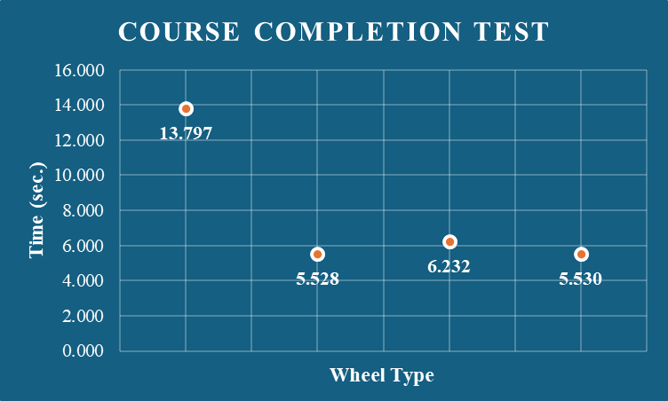
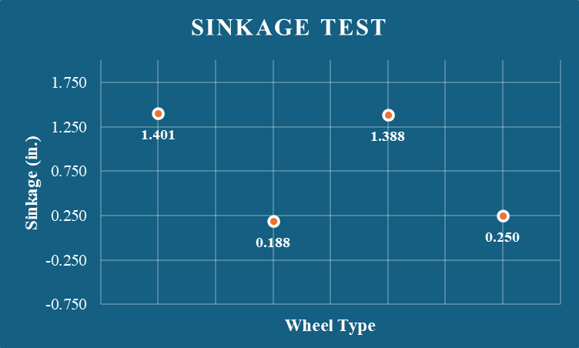
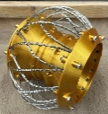
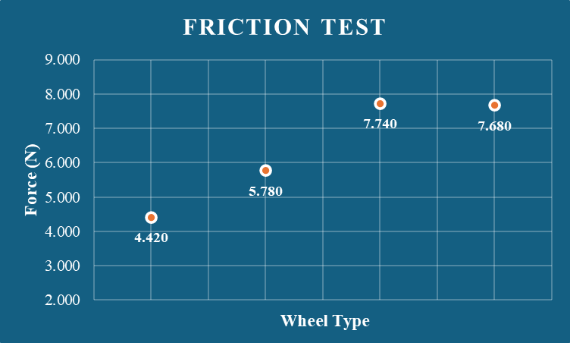
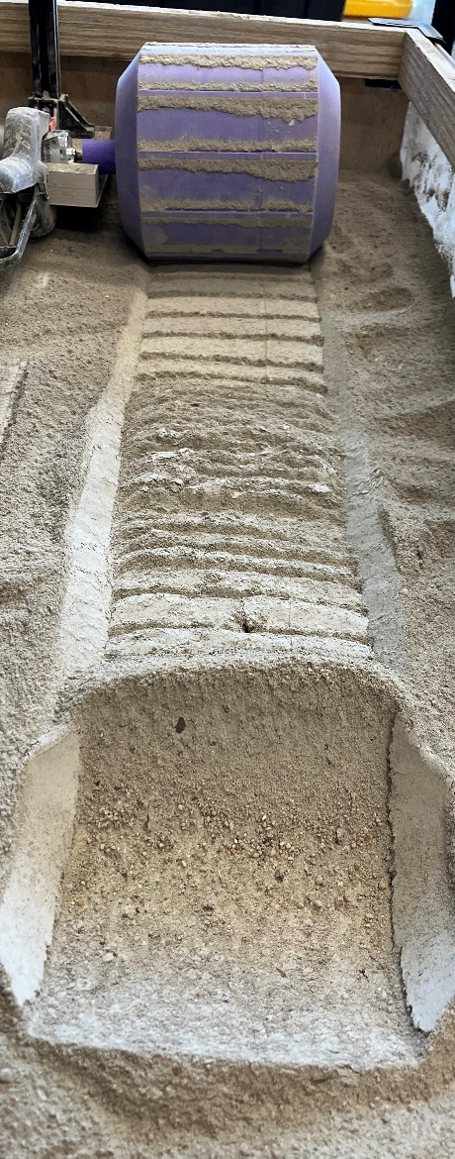
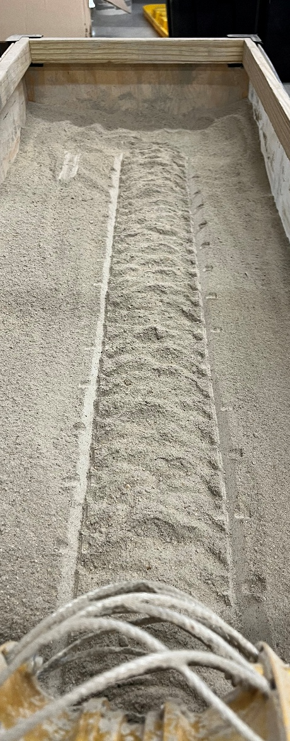
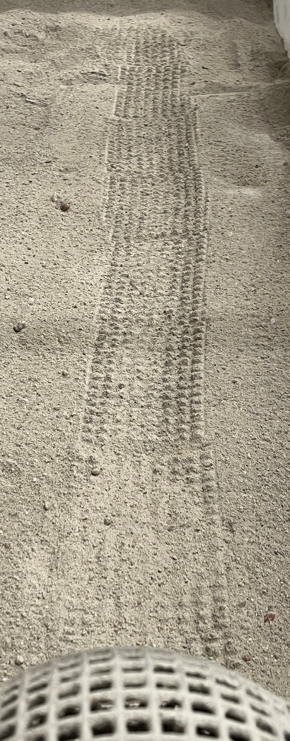
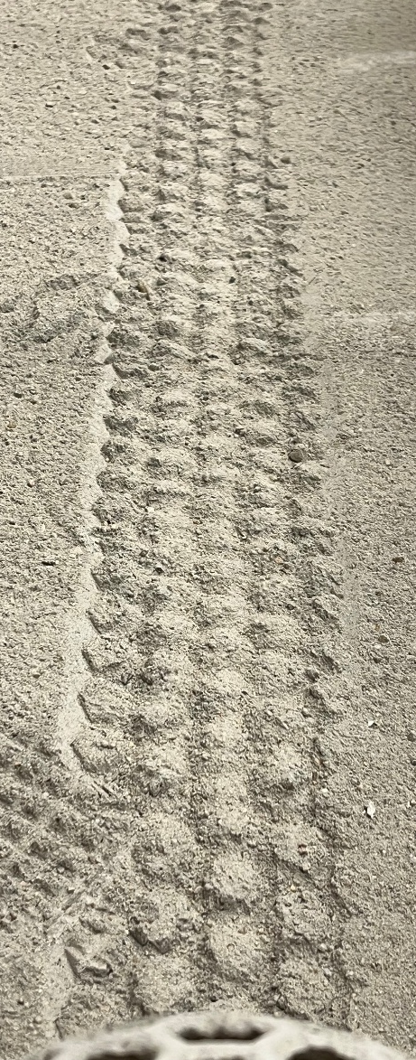
RELLIS Rovers
Lunar Personal Electric Vehicle (LPEV)
Tarleton State University | RELLIS Campus Team Members: Akash Musale, Easton Duplichan, Silas Hill, Swaid Alrashed Contact: akash.musale@go.tarleton.edu | Sharifi@tarleton.edu
Background
New Wheel Designs
FEA (Finite Element Analysis)
This project embarks on an ambitious mission: to revolutionize lunar surface travel for astronauts by introducing a Lunar Personal Electric Vehicle (LPEV). The lunar terrain is notably characterized by extreme temperatures, loose abrasive regolith, and 1/6th of Earth’s gravity.​
Straight Wire FEA: Downforce @ 316.97 N
(Resulted Displacement shown)
Minimum Displacement – 0.00 mm
Maximum Displacement – 0.04057 mm
Minimum Stress – 54.27 N/m^2
Minimum Equivalent Strain – 3.333 X 10^-10
Maximum Equivalent Strain – 8.898 X 10^-5
Objective
To refine and evaluate various wheel designs—Solid, Mesh, Wire, and Honeycomb—through terrain-specific performance tests and finite element analysis, in order to determine the most effective configuration for astronaut mobility on the lunar surface. Additionally, to begin transitioning the vehicle architecture to a more stable and scalable three-wheel platform for full-system integration in future phases.
Cross Wire FEA: Downforce @ 316.97 N
(Resulted Displacement shown)
Minimum Displacement – 0.00 mm
Maximum Displacement – 0.02705 mm
Minimum Stress – 62.93 N/m^2
Minimum Equivalent Strain – 1.143 X 10^-10
Maximum Equivalent Strain – 9.560 X 10^-5
Conclusion
Testing Results
Honeycomb Wire FEA: Downforce @ 316.97N
(Resultant Displacement shown)
Minimum Displacement – 0.00 mm
Maximum Displacement – 0.003788 mm
Minimum Stress – 0.4235 N/m^2
Minimum Equivalent Strain – 3.9 X 10^-12
Maximum Equivalent Strain – 6.128 X 10^-6
Test results indicated that the Wire Mesh wheel designs provided the most balanced performance across all terrain metrics—offering high traction with minimal sinkage and efficient course completion times. Among them, the Honeycomb Wire wheel showed lower stress concentrations and acceptable deformation under lunar gravity simulation in FEA. These findings confirm the potential of flexible mesh-style wheels fabricated with PETG carbon fiber to meet mobility and structural needs for lunar surface travel. Additionally, progress was made toward implementing a three-wheel vehicle design for enhanced balance and control.
Future Considerations:
Full Vehicle Integration: Incorporate the selected wheel design into a functional three-wheel LPEV prototype.
Active Braking System: Develop and test an onboard braking mechanism suitable for lunar terrain.
Wheel Dust Shielding: Investigate protective measures against regolith infiltration into wheel hubs.
Long-Term Durability Testing: Simulate repeated stress cycles to evaluate fatigue resistance.
System Miniaturization: Explore lightweight electronics for efficient power delivery and control.
Acknowledgments
We thank our Capstone Professor, Dr. Nourouddin Sharifi, for aiding in testing and development of ideas.
We thank our NASA mentor, Chatwin Lansdowne, for much needed guidance and feedback.
We are grateful to TSGC for sponsoring our project and we appreciate NASA for administering this design challenge.
We also thank Dr. Landaeta and Dr. Xu for the constant support from Mayfield College of Engineering at Tarleton State University..

